Slide 1
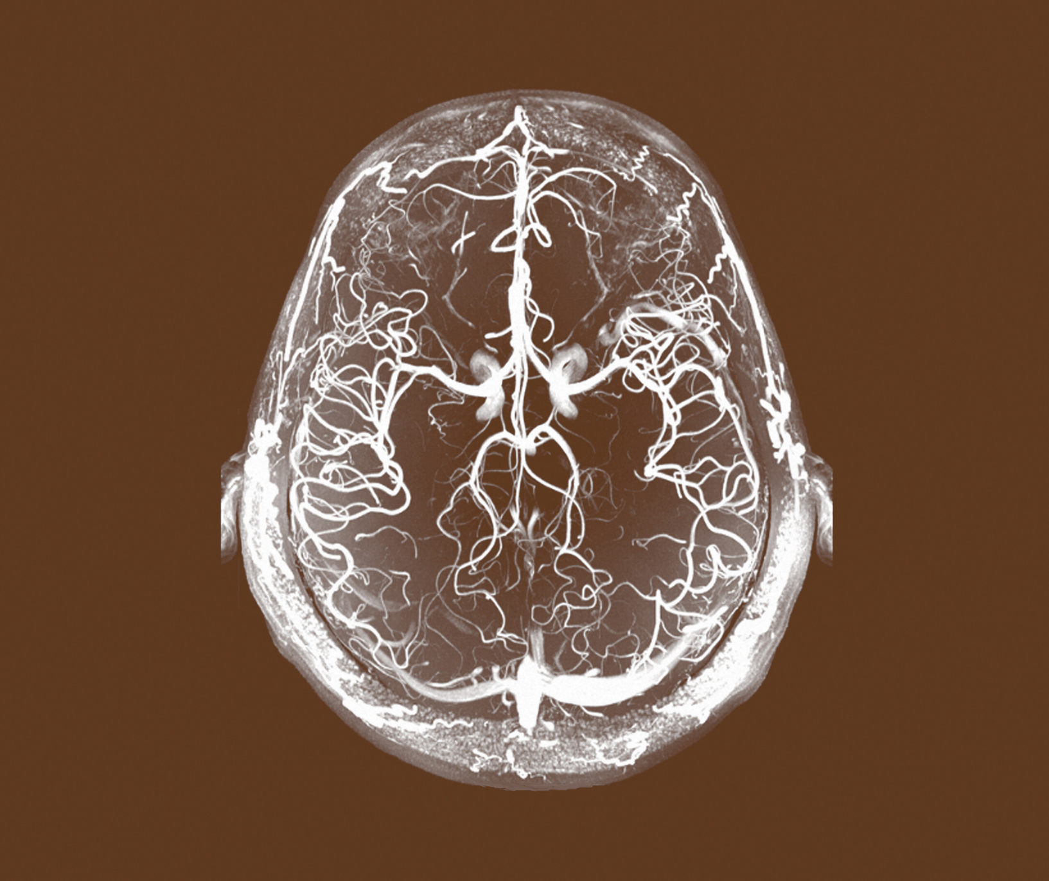
Major Depressive Disorder (MDD)
Definitions and Diagnosis

